Slide 1



CIT 596 MODULE 10.5
Regression
Sampath Kannan

Slide 2



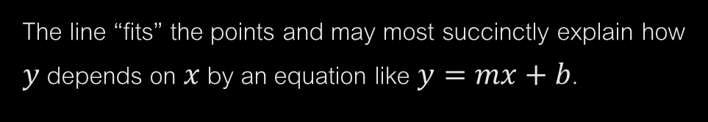
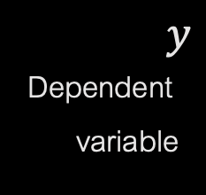

REGRESSION
One final application of dynamic programming: regression.
Important problem in machine learning and data science.
What is regression? General idea:
Given points $\left(x_{1},y_{1}\right),\left(x_{2},y_{2}\right),⋯,(x_{n},y_{n})$ summarize how $y$ depends on $x$.
$y$
Dependent
variable
The line “fits” the points and may most succinctly explain how $y$ depends on $x$ by an equation like $y=mx+b$.
$$x$$
Independent variable

Slide 3

FURTHER DISCUSSION AND EXAMPLE
Suppose $x_{1},x_{2},⋯,x_{n}$ are the amounts you paid for buying gas/petrol at successive times in your new car.
$0,y_{1},⋯,y_{n−1}$ are the miles you were able to travel since the last refill.
Roughly speaking, $y_{i}$ is the number of miles you got for $\$x_{i}$ of gas.
Note the offset in the subscripts: you record $y_{i}$ when you record $x_{i+1}$.
If gas prices stay constant, and the mileage you get per gallon/liter is constant, then you would roughly expect $y$ to depend linearly on $x.$
The goal of linear regression is to find the “best” linear relationship between $x$ and $y.$
Specifically the error of a line $y=mx+b$ is the sum of the squared $y$-distances between the points and the line, i.e., $\sum_{i=1}^{n}{{(mx_{i}+b − y_{i})}^{2}}$

Slide 4

WHAT MORE?
Linear regression is solvable using calculus:
$m=\frac{n\sum_{i}{x_{i}y_{i}}−(\sum_{i}{x_{i}})(\sum_{i}{y_{i}})}{n\sum_{i}{{x_{i}}^{2}}−{(\sum_{i}{x_{i})}}^{2}}$ $b=\frac{\sum_{i}{y_{i}}−m\sum_{i}{x_{i}}}{n}$
But on some data, a single line might have high error.
Perhaps after the new car is broken in, it starts giving better gas mileage, or gas prices fluctuate?
We could try fitting several lines to the points.
But you can always fit $n−1$ lines to any set of $n$ points, each covering two successive points.
Solution: penalize for using each line, minimize this penalty + error in fit.
In machine learning, such a penalty is called a regularization penalty.

Slide 5

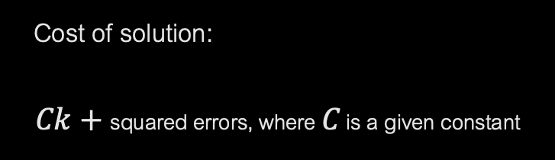
THE PROBLEM
Given points $\left(x_{1},y_{1}\right),\left(x_{2},y_{2}\right),⋯,\left(x_{n},y_{n}\right), \text{with} x_{1}<x_{2}<⋯<x_{n}$
Partition points into some $k$ segments and fit a line through each one.
Cost of solution:
$$Ck+\text{squared} \text{errors}\text{, }\text{where} C \text{is} \text{a} \text{given} \text{constant}$$
Find solution that minimizes the cost

Slide 6

FORMAL STATEMENT OF PROBLEM
Input: $\left(x_{1},y_{1}\right),\left(x_{2},y_{2}\right),⋯,\left(x_{n},y_{n}\right) \text{with} x_{1}<x_{2}<⋯<x_{n}$ and constant $C$
Goal: Choose
$k$ and
$k+1 \text{indices} i_{0}=0<i_{1}<⋯i_{k−1}<i_{k}=n \text{and}$
$k \text{lines}\text{: }y= m_{1}x+b_{1}, y=m_{2}x+b_{2}, ⋯,y=m_{k}x+b_{k}$ to minimize
$$Ck+\sum_{j=1}^{k}{ \sum_{i=i_{j}+1}^{i_{j+1}}{{(y_{i}−m_{j}x_{i}−b_{j})}^{2}}}$$
First term is regularization penalty for using lines: increases with more lines.
Second term is squared errors: each point is evaluated against line for its segment.

Slide 7
UPCOMING
In the next segment, we will see how to solve this minimization problem using dynamic programming.

